Slide 1
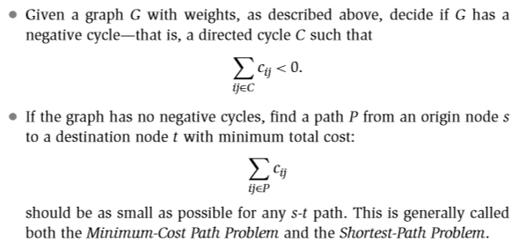
SHORTEST PATH IN THE GRAPH

Slide 2
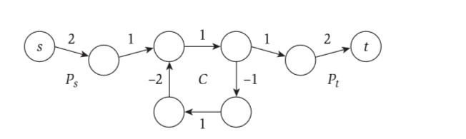
Negative cycle corresponds to profitable sequence of transaction. Buy from i1, sell it to i2, buy from i2 and sell it to i3 and so on arriving back to i1 with a net profit.
we can build an s-t path of arbitrarily negative cost: we ﬁrst use Ps to get to the negative cycle C, then we go around C as many times as we want, and then we use Pt to get from C to the destination t.
We will use dynamic programming to solve the problem of finding shortest path from s to t, when there are negative edge costs but no negative cycles.

Slide 3
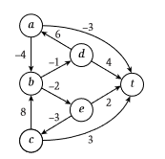
Bellman Ford
.

Slide 4
M(i,v) = min( M[i-1,v], ( min[i-1,w] + Cvw) ) W Ԑ V
M(2,a)= min(M[1,a], min([1,t]+-3) (-3 , 0 - 3) = -3
min([1,b]+-4) ) (-3 , ∞ - 4) = -3
M(2,b)= min(M[1,b], min([1,d]+-1) (∞ , 4 - 1) = 3
min([1,e]+-2) ) (∞ , 2 - 2) = 0
M(2,c)= min(M[1,c], min([1,t]+3) (3 , 0+8) = 3
min([1,b]+8) ) (3 , 0+3) = 3
M(2,d)= min(M[1,d], min([1,t]+4) (4 , - 3+6) = 3
min([1,a]+6) ) (4 , 0+4) = 4

Slide 5
Min(2,e) = min(2, 3-3) =0
min (2,0+2) =2
Min(3,a) = min(-3, 0-4) =-4
min (-3,0-3) = -3
Min(3,b) = min(0, 3-1) = 2
min (0,0-2) = -2
Min(3,c) = min(3, 0+8) =3
min (3,0+3) =3
Min(3,d) = min(3, -3+6) =3
min (3,0+4) =4
Min(3,e) = min(0, 0+2) =0
min (0,3-3) = 2

Slide 6
Min(4,a) = min(-4, -2-4) =-6
min (-4,0-4) = -4
Min(4,b) = min(-2, 3-1) =-2
min (-2,0-2) =-2
Min(4,c) = min(3, -2+8) =3
min (3,0+3) =3
Min(4,d) = min(3, -4+6) =2
min (3,0+4) =4
Min(4,e) = min(0, 0+2) =0
min (0,3+2) =0

Slide 7
Min(5,a) = min(-6, -2-4) =-6
min (-6,0-3) = -3
Min(5,b) = min(-2, 2-1) =-2
min (-2,0-2) =-2
Min(5,c) = min(3, 0+3) =3
min (3,-2+8) =3
Min(5,d) = min(2, -6+6) =2
min (2,0+4) =2
Min(5,e) = min(0, 3-3) =0
min (0,0+2) =0
If the 6th loop also gets the same result then there is no weighted loop in the graph.

Slide 8
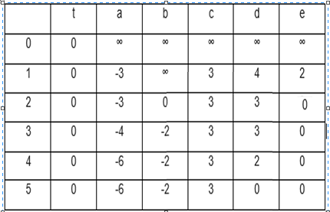
v
i

Slide 9
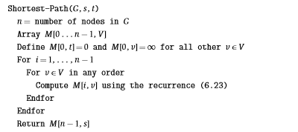

O(VE)
O(V)
O(E)
O(1)

Slide 10
